Slide 1
Advanced Analytics Bootcamp
Module 1: Introduction to Advanced Analytics & Data Science Learning & Development

Slide 2
Over the next 30 minutes, you will be able to…
Understand the ‘big data’ concept
Differentiate between traditional BI and Advanced Analytics
Understand typical Big-data predictions and why and when to use them

Slide 3















The ‘Big Data’ Phenomenon
BIG DATA DRIVERS:
The proliferation of data capture and creation technologies
Increased “interconnectedness” drives consumption (creating more data)
Inexpensive storage makes it possible to keep more, longer
Innovative software and analysis tools turn data into information
More Content
More Devices
More Consumption
New & Better Information
Every gigabyte of stored content can generate a petabyte or more of transient data
The information about you is much greater than the information you create
Big Data encompasses not only the content itself, but how it’s consumed
Source: IDC 2011
Notes:
More data types = more consumer/user flexibility More devices = more access as well as device generated data More consumption (and cheaper storage) = more data (about consumption)
All of this combined; the proliferation of analytics tools, demand for metrics makes “the “big data” phenomenon”… And this will be an heavily changing world.

Slide 4
New Types of Data are Emerging

Slide 5
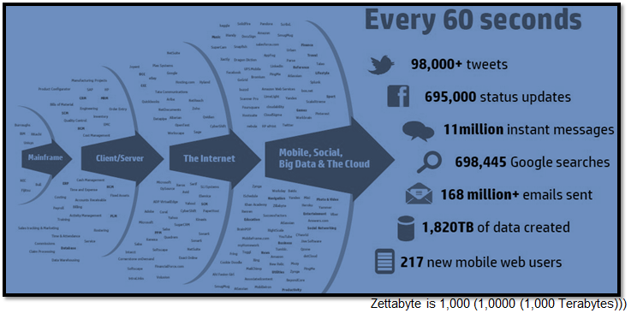
Nobody Knows What Tomorrow Will Bring
Data is growing exponentially and is expected to increase in excess of 32 ZB by 2020. Mobile, social, and cloud based data sources are rapidly changing and becoming more important in the decision process. As a result, the rate at which data is being produced is far exceeding our traditional ability to extract value from it.
Notes:
Volume
Big databases are 1- 5 terabyte.
32 Zb, a size of 32 Billion terabytes.
This requires a plural of data sources and structures to be aligned and analysed in a way that similar to traditional BI. - analyse data in transit
only has value for a very short moment, the analyse needs to be done inline.

Slide 6





Big data initiatives span four unique dimensions
Data is constantly changing, comes in different forms, and is always in doubt. No one type of information architecture can fit all data needs and is often the a source of failure in information centric companies.
Volume
Velocity
Variety
Veracity
Notes:
Volume
Nowadays’ large-scale systems are awash with ever-growing data, easily amassing terabytes or even petabytes of information
Velocity
Time-sensitive processes, such as bottleneck detection and service QoS prediction, could be achieved as data stream into the system.
Think of milliseconds to seconds to react.
Veracity
Detecting and correcting noisy and inconsistent data are important to conduct trustable analysis. Establishing trust in big data presents a huge challenge as the variety and number of sources grows
Variety
Structured and unstructured data are generated in various data types, making it possible to explore new insights when analysing these data together
Challenges:
Incompatible data formats
non-aligned data structures
Inconsistent Data-semantics

Slide 7




Evolution of the Traditional to Big Data Approaches
IT: Structures the data to answer that question
Business: Users
Determine what question to ask
TRADITIONAL APPROACH
Structured & Repeatable Analysis
Monthly sales reports
Profitability analysis
Customer surveys
BIG DATA APPROACH
Iterative & Exploratory Analysis
Brand sentiment
Product strategy
Maximum asset utilisation
IT: Delivers a platform to enable creative discovery
Business: Explores what questions could be asked
Notes:
More data structures, more sources
Some data needs to be given a temporal structured for analysis
Time constrained (current analysis-method would take too long).
Enriches BI
Exploratory Analyses (What if, Which groups, What influences?)

Slide 8
Data Science
Refers to study of generalizable extraction of knowledge from data through solving complex data problems by employing deep expertise in scientific disciplines

Slide 9
It is Different from Business Intelligence
BUSINESS
INTELLIGENCE
DATA
SCIENCE
Confirmation
PHILOSOPHY
Revelation
Areas We Know
KNOWLEDGE
Areas We Don’t Know
Descriptive & Summary
MODELS
Machine Learning, Predictive, Prescriptive
Shallow Learning
INSIGHTS
Deep Learning
Operational
OUTCOME
Value Generation
Repetitive
WORKLOAD
Experimental and Adhoc
GBs to 10s of TBs
VOLUMES
10s of TB to 100’s of PB’s
Notes:
Recap of earlier points
Exploratory analyses, find things you don’t know (for sure).
More data → Different way of interpretation → Statistical analysis
Simplistic way of asking, due to data-size, a correct answer.
Common scenario: Customer Basket, Predictive (if I do X, what happens to Y), prescriptive (If X happens and I do Y, what is the result?)
Shallow learning → Alerts / KPI. A simple ‘how far am I off the mean’-KPI can be determined as shallow learning. It means the interpretation is adjusted to the input data.

Slide 10
The Who, What, When and Why?

Slide 11
Complexity of Analytics Services drives the journey from Data to Insight
Data
Information
Insight
High
Predictive Analytics
Optimisation
Prescriptive
What’s the best action to take?
Predictive Modelling
What will happen next?
Tactical Analysis
Forecasting
Predictive
Complexity
Statistical Analysis
What if these trends continue?
Alerts
Why is this happening?
Query Drill Down
Diagnostic
What needs attention?
Reporting
Ad Hoc Reports
Standard Reports
Where exactly is the problem?
How many, how often, where?
Descriptive
Low
Cleaned Data
What happened?
Big Data and Analytics range from reporting and forecasting to advanced predictive models and optimized decisions
Notes:
Shallow learning → Alerts / KPI. A simple ‘how far am I off the mean’-KPI can be determined as shallow learning. It means the interpretation is adjusted to the input data.

Slide 12
Comparison (1/2)
DESCRIPTIVE
PREDICTIVE
PRESCRIPTIVE
What HAS happened?
Increase asset reliability
What COULD happen?
Predict infrastructure failures
Forecast facilities space demands
What SHOULD happen?
Increase asset utilization
Optimize resource schedules
Why maintenance costs are high
The value of the materials inventory
When to consolidate underutilized facilities
How to determine costs to improve service levels
Where to optimally route service technicians
Which strategic facilities plan provides the highest long-term utilization
The number and types of asset failures
How to anticipate failures for specific asset types
How to increase asset production
Reduce labor and inventory costs
What the user needs to DO
What the user needs to KNOW
Notes:
(Introduction of our ‘fictitious company’ that sells socks and fashion.).
The data that they track: Store-Shelve, Warehouse, Shipping, Manufacturing and sales.
This allows us to track supply chain and identify bottlenecks (ships that are late etc.) or cost-increases (warehouses that never fill up etc.).
This company wants to optimize it’s assets
How does analytics help, what questions and steps do we see?
If we take the Company from Slide 9, what kind of data sources/challenges do we have in the different stages.

Slide 13
Comparison (2/2)
DESCRIPTIVE
PREDICTIVE
PRESCRIPTIVE
What HAS happened?
Standard reporting – What happened?
What COULD happen?
Predictive modeling – What will happen next?
What SHOULD happen?
Optimization – What is the best possible outcome?
Query/drill down – Where exactly is the problem?
Ad hoc reporting – How many, how often, where?
Alerts, reports, dashboards, business intelligence
Forecasting – What if these trends continue?
Simulation – What could happen?
Alerts – What actions are needed?
Random variable optimization – What is the best outcome given the variability in specified areas?
Predictive models, forecasts, statistical analysis, scoring
Business rules, organization models, comparisons, optimization
How analytics gets ANSWERS
What makes this analysis POSSIBLE

Slide 14

Example:
Descriptive Analytics
Predictive Analytics
Prescriptive Analytics
Notes:
Our sportswear company. The data that they track: Store-Shelve, Warehouse, Shipping, Manufacturing, sales orders.
This allows them to track supply chain and identify bottlenecks (ships that are late etc.) or cost-increases (warehouses that never fill up etc.).
Manufactoring:
Low Wage Countries
Freight by ships
Warehousing in Europe
Bought shelve-space as brand-, department- stores
High income; blend Sportsware
Low income – High attractiveness: Colourfull fashion ware.
Inhouse fashion-designers.
Standard bi:
Clean, Combine Data.
Standard Reports.
Excel Interface to the data.
Alerts based on KPI’s.
Complications: Summer-wear, winter-wear, special editions.
Predictive:
Case 1: Can we predict the next summer’s colour-trends? What data do we have that is indicative to the case?
Optional; if we include previous sales, used colours in fashion-wear, period and average temperature. Can we say anything about the expectations of this year?
In case of too much time:
Case 2: Sports wear. Can we predict the amount of store-sales so we can avoid running out of shelve-space? What indicators can we use?
Weather, sporting-events, summer / new year – fads
Why do we want to for-cast, something that will eventually sell with little to no waste? Optimize Sales-chain, lower shelve-time → Cost Saving.
Based on our previous model, we created a predictive model that is trained with old data.
Case 1: The colours for this summer are green (98%), yellow (87%) and red (64%). The indicators are: Temperature, Period, and Date/time.
The weather station tells you the temperature for the coming summer are about 2 degree’s lower than normal. So you enter the data and use the model to create a new prediction for comparison to the old one. Now you see the numbers shifted: green (96%), yellow (92%) and blue (65%).
Now the future changes and thus decisions should be made on manufacturing: Higher amounts of Yellow. Slightly lower amounts of green. Lower amounts of red. Can we still produce blue?

Slide 15
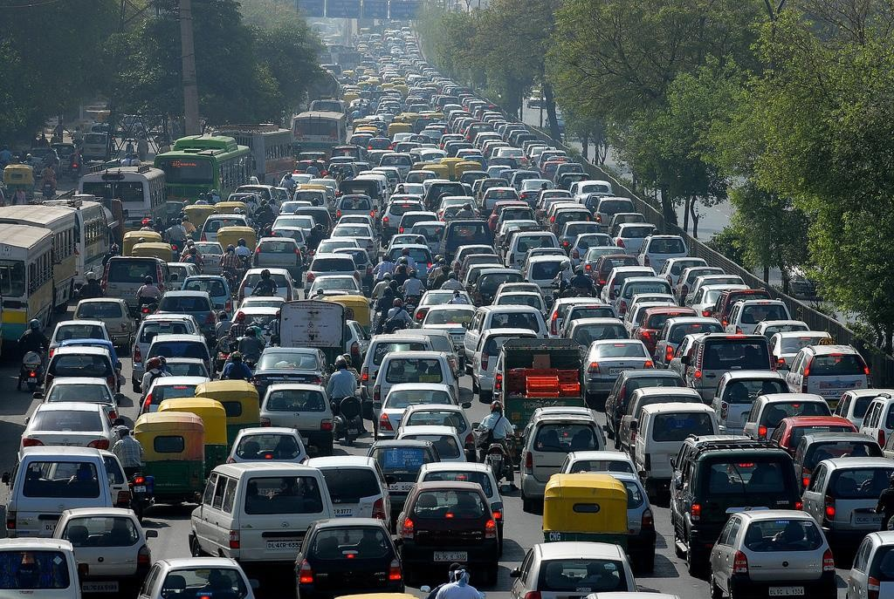
Traffic Management: Descriptive
Prescriptive
Predictive
Value
Descriptive
Difficulty
Notes:
Descriptive [Informing Role]:
Traffic jam has happened already
[Implicit: Do something about it]

Slide 16
Traffic Management: Predictive
Prescriptive
Predictive
Value
Descriptive
Difficulty
Notes:
Predictive [Informing and Warning Role]:
Traffic jam is about to happen in the next 30 minutes
[Implicit: Do something before it happens]

Slide 17
Traffic Management: Prescriptive
Prescriptive
Predictive
Value
Descriptive
Difficulty
Notes:
Prescriptive [Informing, Warning and Advisory Role]:
Take action so traffic jam does not happen

Slide 18


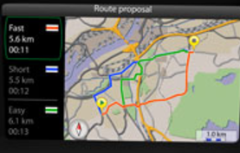

Predictive Analytics
Descriptive Analytics
Diagnostic Analytics
Prescriptive Analytics
Cognitive Analytics

Slide 19
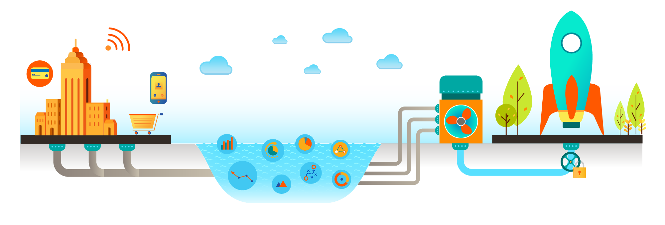

Avanade’s Modern Analytics Platform is an accelerator for Advanced Analytics via 4 simple steps
Unify:
Data Pipelines
Enrich: Data Lake
Unlock: Analytics
Enable:
Experience
First, we UNIFY the data that matters.
We shatter data silos and connect your business with your customers
Then, we ENRICH that data with more data from trusted 3rd party sources to expand insight
That allows us to UNLOCK insights and provide them to every person and app that needs it
Finally, we ENABLE clients to plan and act based on insights, not guesses
Notes:
Wrapup – of case examples.

Slide 20

You learnt so far…
Why we engage in Data Analytics
The stages of Data Analytics
How it compliments traditional BI
What options we have to support business cases
Remember:
While big data analytics is very complex when addressed as the whole,
individual components are simple and often organic in nature There are no single right answers to solving big data analytics problems,
but there are a lot of wrong ones

